Slide 1
The History of the Emojis
Ancestors - Smiley - Emoticon - Kaomoji - Emoji

Slide 2
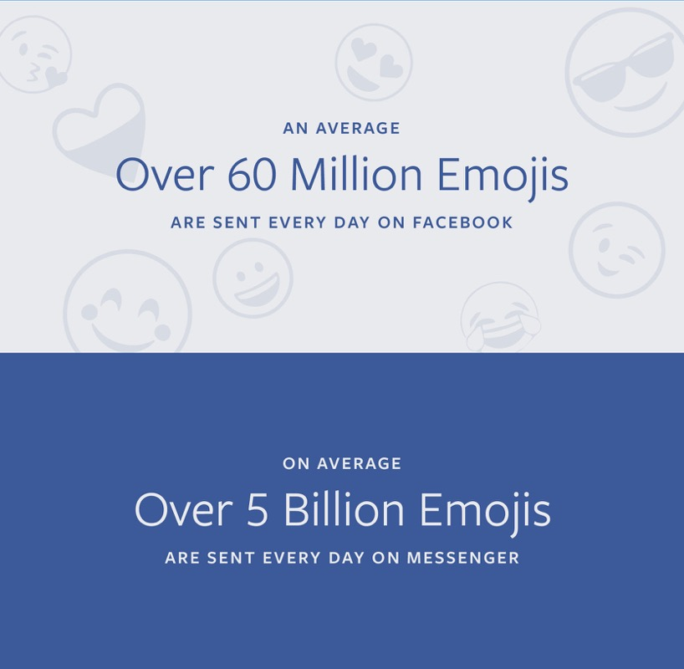
Emojis Sent Daily on Facebook (2017)
Image: Facebook

Slide 3
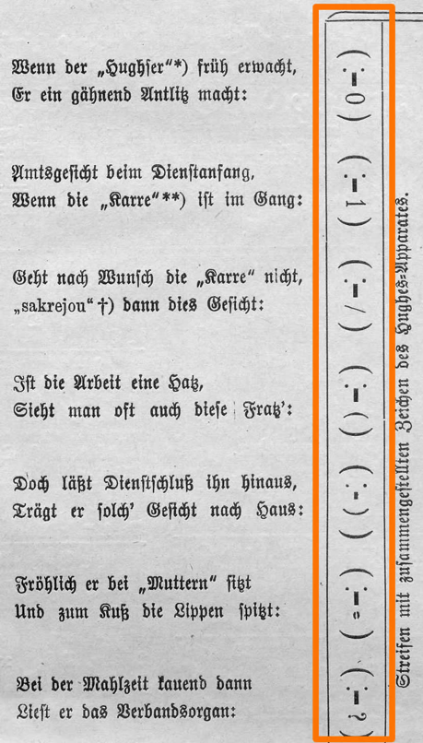
Ancestors of the Emoticons
Already centuries ago, typesetters tried to represent faces with punctuation marks or letters.
The experiment of the American magazine "Puck“ in 1881 is famous. > see next slide

Slide 4
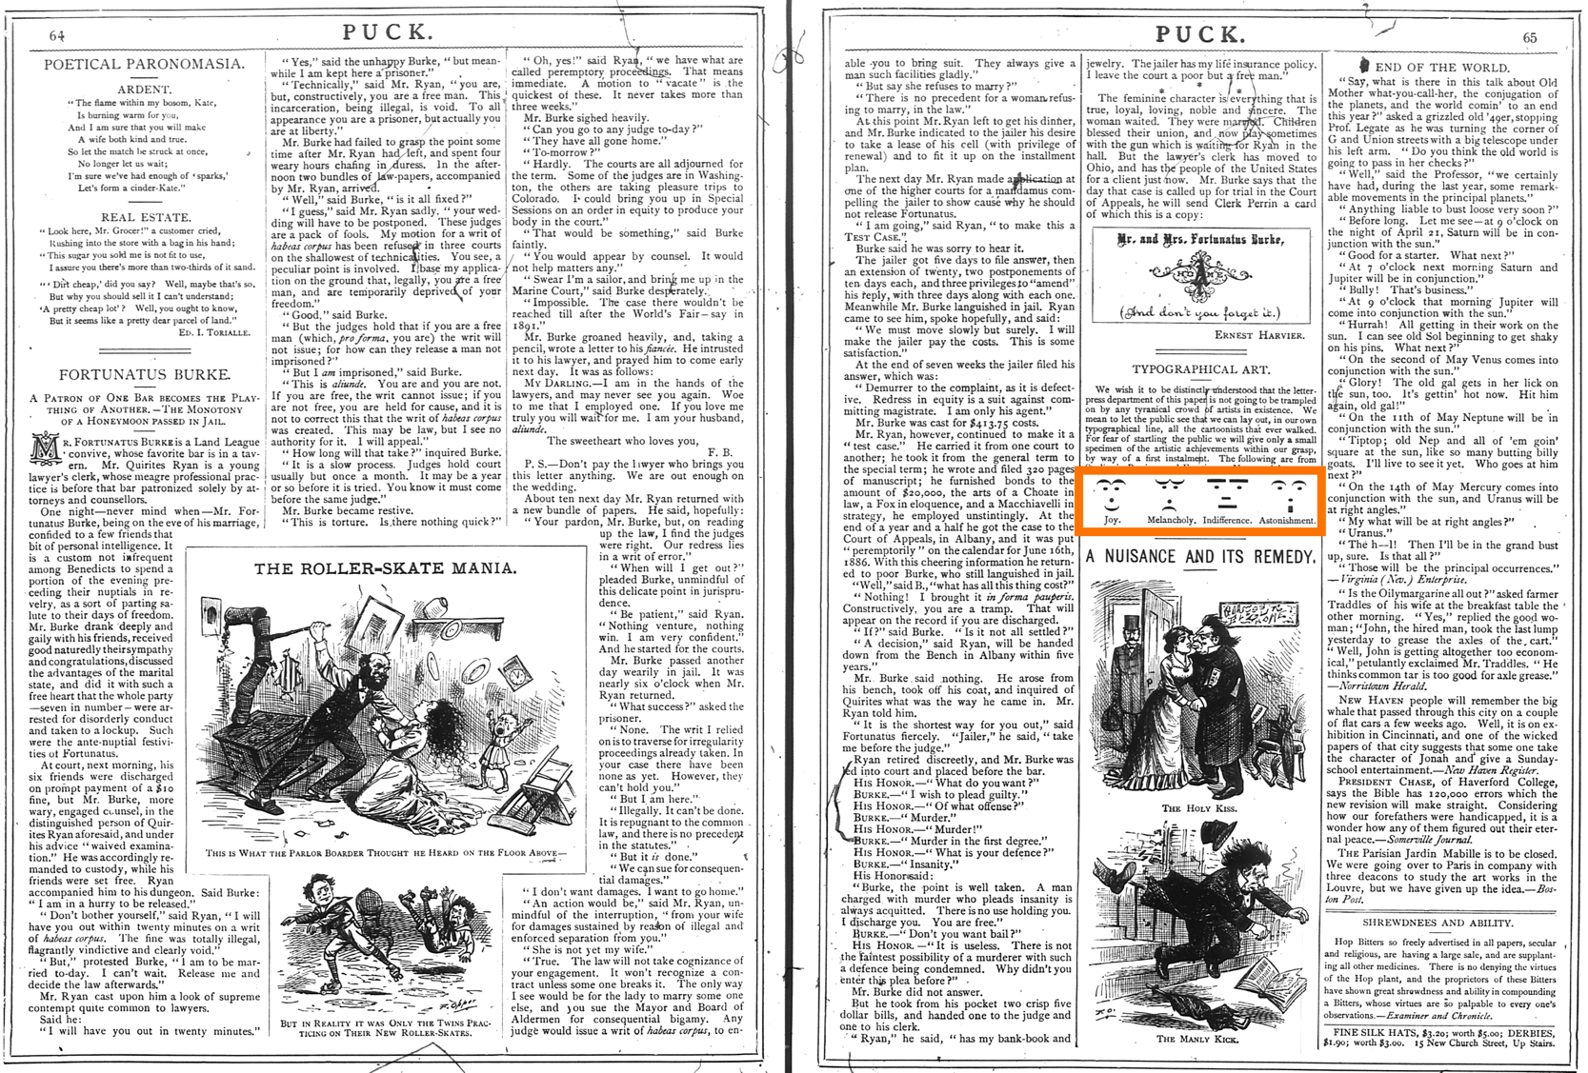
“Puck”
1881

Slide 5
1963: The Smiley is invented
The Smiley was invented in 1963 by the graphic artist Harvey Ross Ball in Worcester, Massachusetts, USA.
At that time, he was asked to draw a graphic to improve the mood of the employees of an insurance company.
Harvey Ball completed the design in less than 10 minutes and earned $45 for his work.

Slide 6
The Second Most Famous Smile
The original Smiley has two differently sized oval eyes.
The mouth is not a perfect geometric bow.
The most famous smile in the world, that of Mona Lisa, has often been compared to the smiley.

Slide 7
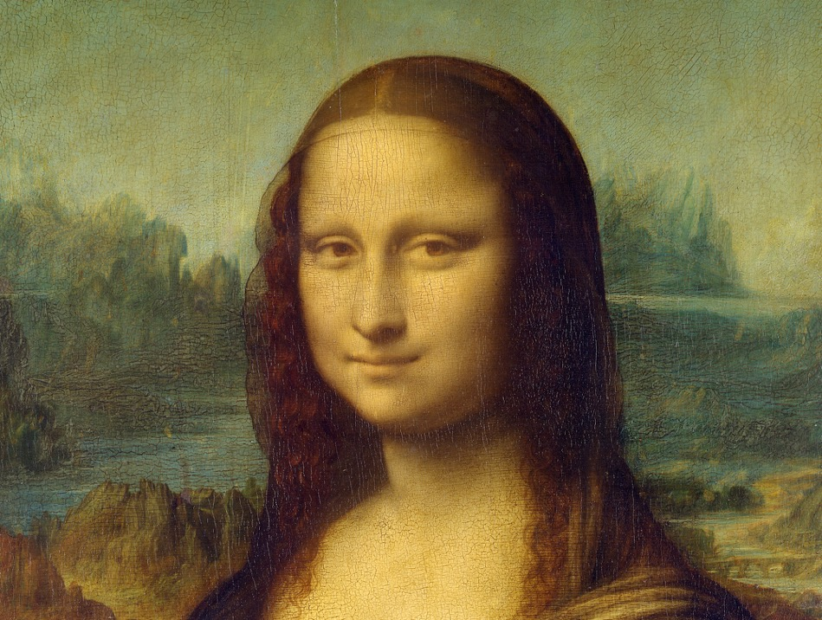
The Most Famous Smile in the World
Mona Lisa by Leonardo da Vinci

Slide 8
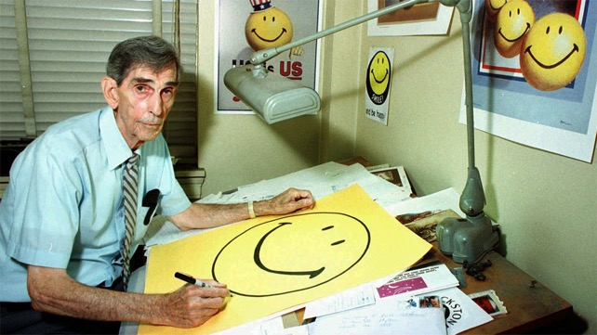
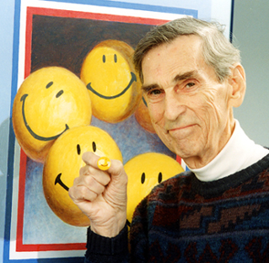
No Copyright for the Smiley …
Harvey Ball didn't realize what he had created. He forgot to copyright his work.
Others made hundreds of millions of dollars with the Smiley on clothes, hats, toys, etc. shortly after. > see next slide

Slide 9
Items of the “Smiley Company” (2019)

Slide 10
1982: Scott Fahlman invents emoticons
emotion + icon = emoticon
At that time, the Internet did not yet exist in its modern form. The network was called ARPANET. But it was already possible to create a kind of blog and send messages.
Scott Fahlman suggested that the posts, which are not really serious, should be marked with this string: :-)

Slide 11
The New “Joke Marker”
19-Sep-82 11:44 Scott E Fahlman :-)
From: Scott E Fahlman <Fahlman at Cmu-20c>
I propose that the following character sequence for joke markers:
:-)
Read it sideways. Actually, it is probably more economical to mark
things that are NOT jokes, given current trends. For this, use
:-(

Slide 12
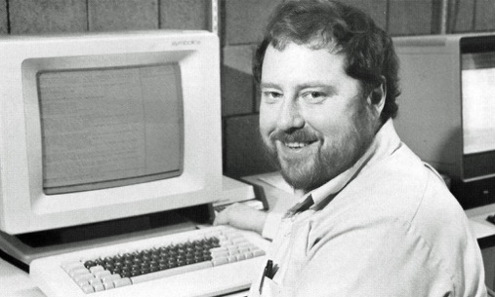
Scott Fahlman in a Interview
This was 10 minutes of my life, just part of a silly online discussion more than 35 years ago. So, it’s kind of a strange thing to be famous for, but it’s fun to be a little bit famous for something. I’ve come to accept that no matter what I achieve in my career as an AI researcher, the first sentence of my obituary will talk about the smiley face invention.

Slide 13
Late 1990s: SMS, E-Mail and Internet
With the growing use of SMS and the frequent writing of E-mails, emoticons have also become more and more popular.
The number of emoticons is increasing and everyone has his own favorites.
A smile can't be only a :-), there are several variations of it now: :) =) :] :> :c) x) :o)

Slide 14
The Eastern Way: Kaomojis
Just four years after Fahlman, the first smiley face (^_^) appeared on the Japanese ASCII-NET, an online web service. The Kaomojis (顔文字) are born.
顔 kao = face, 文 mo = write, 字 ji = character
Japanese loved their Kaomojis very much, a real mania began.
Nowadays there are countless of these symbols, the real number can only be estimated.

Slide 15
Emoticons vs. Kaomojis
Kaomojis are not shown sideways, they are to be understood vertically. :-) (^_^)
In the West, emotions in emoticons are generated mainly with the mouth, in the East, however, with the symbols for the eyes. This has to do with the fundamental cultural differences of facial expressions.

Slide 16
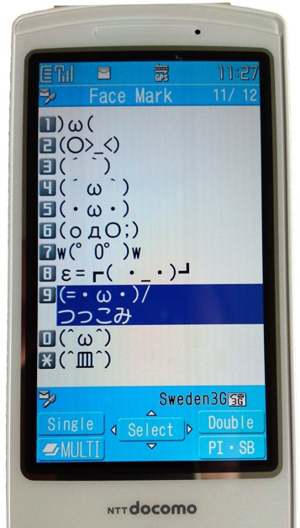
Can you read the emotion?
Watch the eyes, not the mouth! (^.^) \(^_^)/ (^_^)/" (^_~) (-.-) d(^_^)b \(*-*)/ (+_°) (>_<) (^)(>.<)(^) (-_-) (ô_o) (O_O) (^_^)" (^_^;) (o_O) (3>_<3) (._.); (+.+) (ö_ö) (~_~)

Slide 17
1997: The Emojis are born …
... and nobody notices it.
The first mobile device with an "Emoji picker" was a device called "SkyWalker DP-211SW" from Pioneer.
The emoji set, that was part of it, was designed by the Japanese company “SoftBank”.
Surprisingly nobody noticed that this was a sensation. So the device was sold very badly and was quickly forgotten.

Slide 18
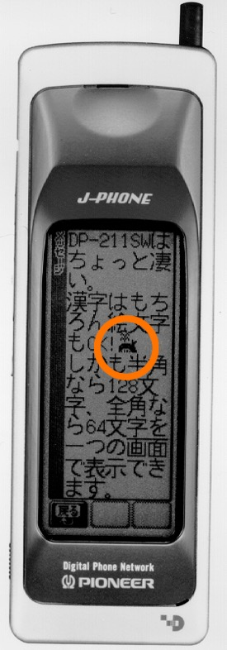
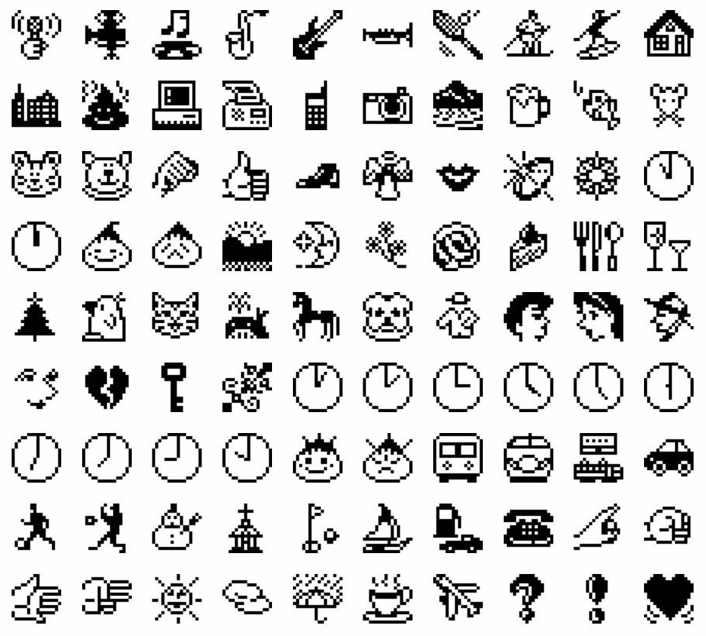
Whale Watching
The first (“unofficial”) Emoji set:

Slide 19
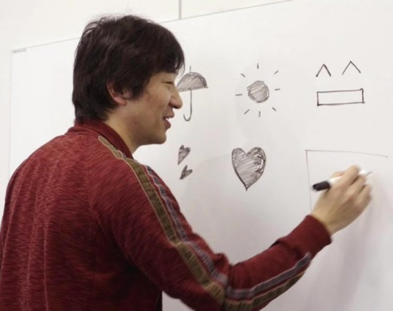
Is This Man the Creator of the Emojis?
Shigetaka Kurita, a Japanese interface designer, created the first “official” generation of Emojis in 1999. At that time, he worked for the Japanese telecom giant "NTT DoCoMo".
絵 e = picture, 文 mo = write, 字 ji = character
Kurita, who was just 25 years, designed a set of 176 pictograms (today there are almost 2700 Emojis).

Slide 20
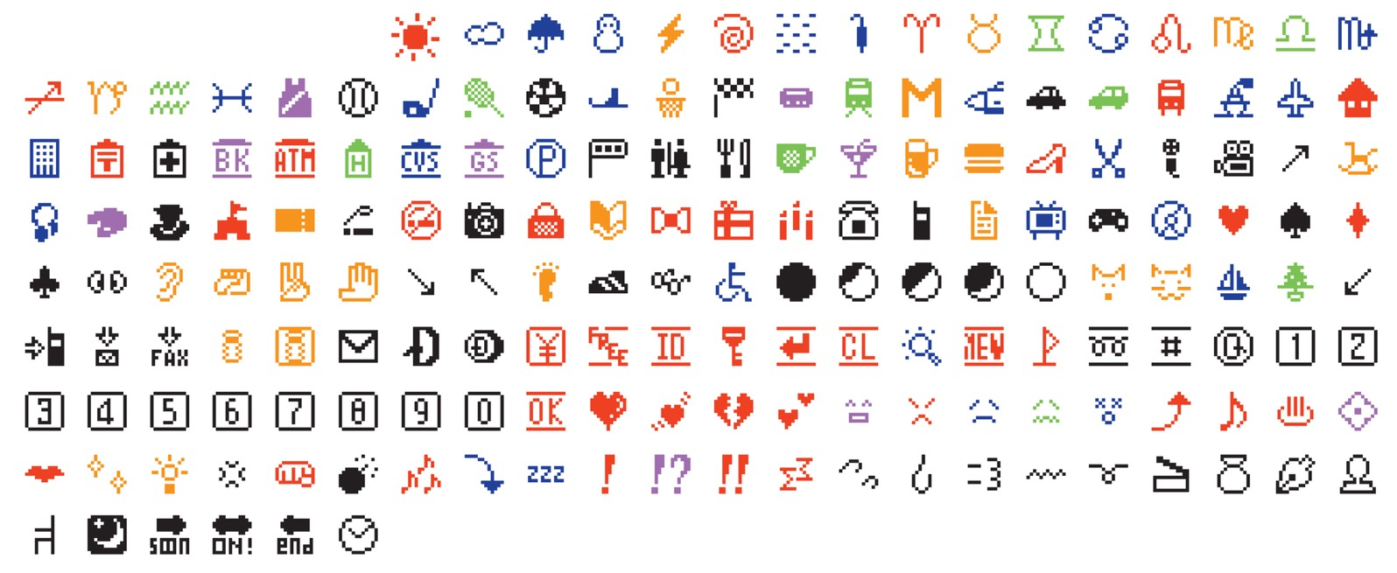
The “first” generation of Emojis

Slide 21
144 pixels had to be enough
The first generation consisted of bitmap images and not vector graphics like today.
All of them were within a grid measuring 12 by 12 pixels, that's a total of 144 pixels.

Slide 22
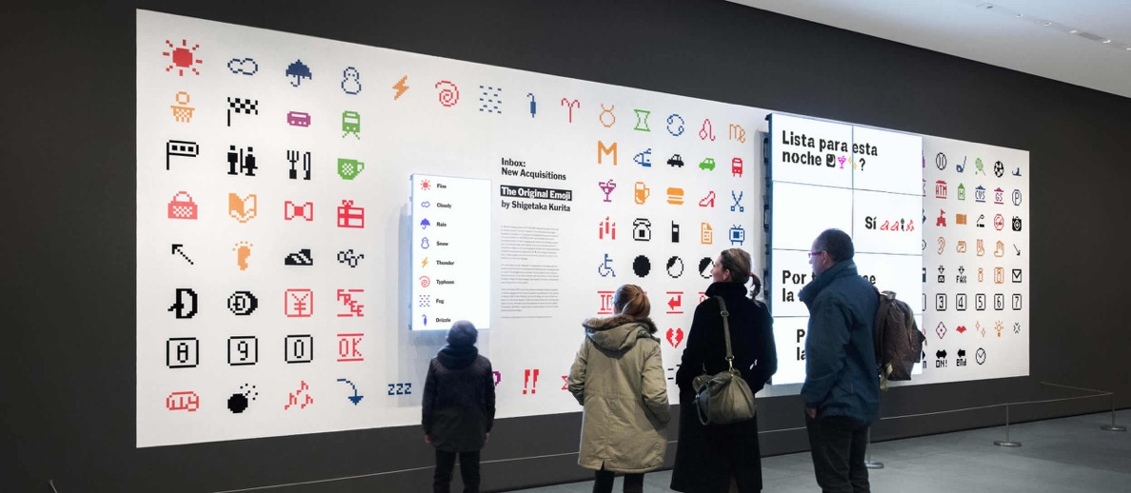
Are Emojis Art?
In 2016 the set was added to the collection of the famous Museum of Modern Art (MoMA) in New York.

Slide 23
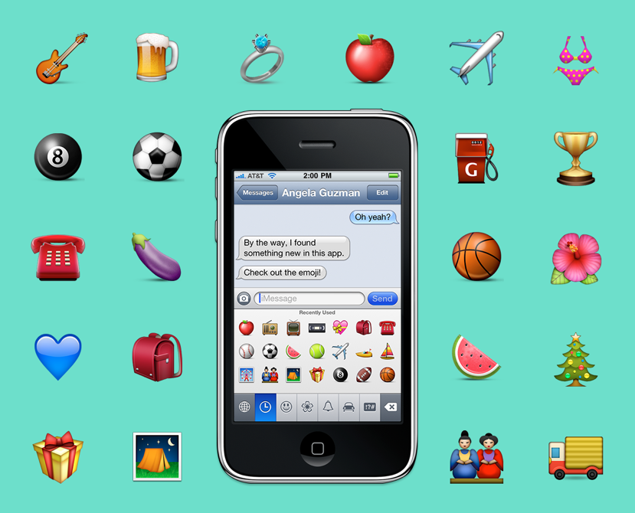
2008: The Emojis Infect Apple's iPhone
The first emojis were restricted to iPhone users in Japan.
Three years later, in 2011, all iPhone owners around the world were able to use Emojis. On the right side: Angela Guzman's iPhone. She was in the team that designed the first Emoji set for Apple.

Slide 24
2014: The "Book From the Ground"
In 2014, the Chinese artist Xu Bing (徐冰) published a new type of book.
A book without words, recounting one day in the life of an office worker (Mr. Black), told exclusively in symbols, icons and logos.
Xu Bing spent seven years collecting materials, experimenting and arranging thousands of pictograms.

Slide 25
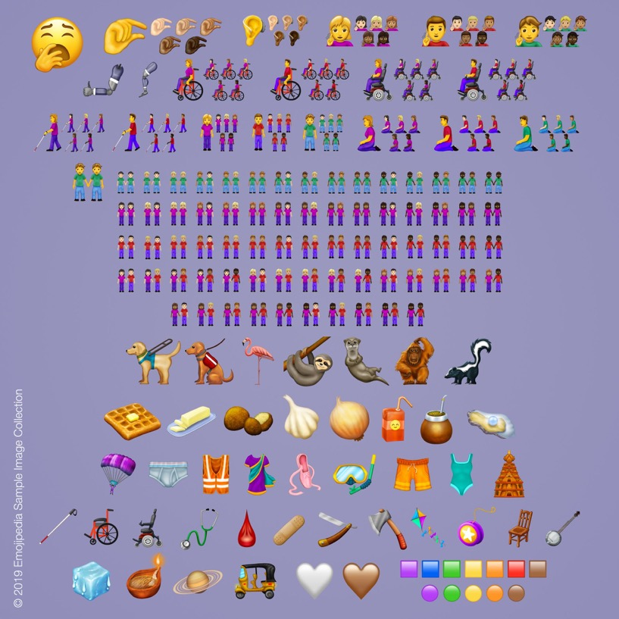
The Emojis are Growing and Evolving
Here is an example
of the new Emojis
that were added in 2019

Slide 26
References
Used on several slides/topics
Wikipedia
https://de.wikipedia.org/wiki/Emoticon
https://en.wikipedia.org/wiki/Emoticon
https://de.wikipedia.org/wiki/Emoji
https://en.wikipedia.org/wiki/Emoji
Emojipedia
https://blog.emojipedia.org
https://emojipedia.org
Smiley
The World Smiley Foundation: "About Harvey Ball"
http://www.worldsmileday.com/index.php/article-index/item/380-about-harvey-ball
Smithsonianmag: "Who Really Invented the Smiley Face?"
https://www.smithsonianmag.com/arts-culture/who-really-invented-the-smiley-face-2058483/
By Jimmy Stamp, March 13, 2013
Medium: Invention of Smiley Emoticon (Harvey Ross Ball)
https://medium.com/@gunjanhurkat/invention-of-smiley-emoticon-harvey-ross-ball-632453022041
By Gunjan Hurkat, June 19, 2018
Emoticon and Kaomoji
"Emojis and beyond - USING IMAGES, NOT WORDS."
http://www.johngrimwade.com/blog/2017/02/20/emojis-and-beyond/
Post by Nigel Holmes, February 20, 2017
Deutschlandfunk: Die Erfindung des Emoticons
https://www.deutschlandfunk.de/vor-35-jahren-die-erfindung-des-emoticons.871.de.html?dram:article_id=396063
By Lea Albrecht, September 19, 2017
culture trip: https://theculturetrip.com/north-america/usa/pennsylvania/articles/meet-scott-fahlman-the-guy-who-created-the-first-emoticon/
Meet Scott Fahlman, the Guy Who Created the First Emoticon
(The quote on slide 11 also comes from there)
by David Kindervater, Updated: March 21, 2018
UNRAVEL: Kaomoji as expression: Japanese emoticons in digital communication
https://unravellingmag.com/articles/kaomoji-as-expression/
by Min Lim, December 28, 2016
Emojis
Emojipedia: Correcting the Record on the First Emoji Set
https://blog.emojipedia.org/correcting-the-record-on-the-first-emoji-set/
by Jeremy Burge, March 8, 2019
MoMa: The Original NTT DOCOMO Emoji Set Has Been Added to The Museum of Modern Art’s Collection
https://stories.moma.org/the-original-emoji-set-has-been-added-to-the-museum-of-modern-arts-collection-c6060e141f61
by Paul GallowayFollow, October 26, 2016
It's nice that: MoMA acquires the first ever emojis by Shigetaka Kurita
https://www.itsnicethat.com/news/moma-acquires-first-ever-emojis-by-shigetaka-kurita-271016
by Jenny Brewer, October 27, 2016
Digisaurier: INTERNET-HELDEN (5): SHIGETAKA KURITA, DER EMOJI-ERFINDER
https://www.digisaurier.de/internet-helden-5-shigetaka-kurita-der-emoji-erfinder/
by Rainer Bartel, November 14, 2018

Slide 27
Images
Slide 3
https://commons.wikimedia.org/wiki/File:Emoticons-Telegraphische_Zeichenkunst.jpg
Deutsche Postzeitung, VII. Jahrgang, Nr. 22, 16.11.1896, p. 497
Slide 4
https://de.m.wikipedia.org/wiki/Datei:Puck_No212_p64f.png
Puck magazine issue 212, March 30th, 1881. Microfilm scan from American Periodicals III, Ann Arbor University Microfilms. Scanned at the University of Illinois at Urbana-Champaign.
http://www.johngrimwade.com/blog/2017/02/20/emojis-and-beyond/
Post by Nigel Holmes, The image was most likely redrawn
Slide 5:
http://www.worldsmileday.com/index.php/article-index/item/380-about-harvey-ball
Slide 6:
https://www.redbubble.com/de/people/teecrates/works/28619172-the-original-smiley-face
Slide 7:
https://commons.wikimedia.org/wiki/File:Mona_Lisa,_by_Leonardo_da_Vinci,_from_C2RMF_retouched.jpg
Slide 8:
https://medium.com/@gunjanhurkat/invention-of-smiley-emoticon-harvey-ross-ball-632453022041
https://commons.wikimedia.org/wiki/File:HarveyBall.jpg
Slide 9:
Smiley Company
https://smiley.com/shop
Slide 12:
https://theculturetrip.com/north-america/usa/pennsylvania/articles/meet-scott-fahlman-the-guy-who-created-the-first-emoticon/
Slide 16:
https://commons.wikimedia.org/wiki/File:It%27s_all_about_the_smilies_(3578588882).jpg
Author: Karl Baron
Slide 18:
https://twitter.com/Emojipedia/status/1104076077104803842
https://internet.watch.impress.co.jp/www/article/970925/jphone.gif
Slide 19:
https://www.digisaurier.de/internet-helden-5-shigetaka-kurita-der-emoji-erfinder/
Slide 20:
https://stories.moma.org/the-original-emoji-set-has-been-added-to-the-museum-of-modern-arts-collection-c6060e141f61
Slide 21:
https://stories.moma.org/the-original-emoji-set-has-been-added-to-the-museum-of-modern-arts-collection-c6060e141f61
Slide 22:
https://www.elle-kim.com/The-Original-Emoji-by-Shigetaka-Kurita
Slide 23:
https://twitter.com/agzmn
Slide 24:
Scan from "Book from the Ground", Bing Xu, MIT Press 2014, p. 6
Slide 25:
https://blog.emojipedia.org/230-new-emojis-in-final-list-for-2019/
https://emojipedia.org/emojipedia/12.0/new/

